Slide 1

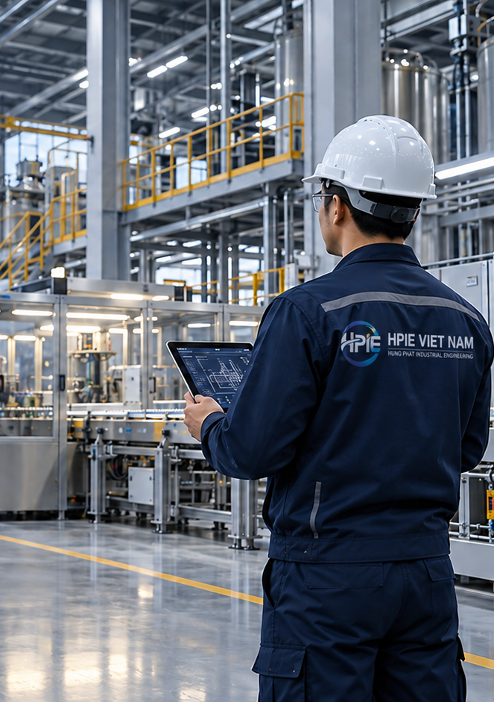
HPIE VIET NAM
2026
HUNG PHAT INDUSTRIAL ENGINEERING | CAPABILITY STATEMENT
INDUSTRIAL MACHINERY • ENGINEERING • PROJECT SOLUTIONS
LOCAL TECHNICAL &
PROJECT SUPPORT
FOR FOREIGN INDUSTRIAL
EQUIPMENT
IN VIETNAM
A practical local partner for site readiness, installation coordination,
commissioning, after-sales support and Vietnam market development.
AT A GLANCE
What HPIE brings to an OEM project
LOCAL TECHNICAL PRESENCE
PROJECT EXECUTION
MARKET DEVELOPMENT
Hanoi-based support for projects in
Northern Vietnam, connecting OEM
engineers, customers, contractors and
site teams.
Site survey, readiness checks,
installation coordination, MEP and
contractor coordination, commissioning
support and punch-list follow-up.
Customer identification, technical
inquiries, RFQ follow-up and
step-by-step Vietnam market
development for foreign manufacturers.
CORE CAPABILITIES
End-to-end local support
01 SITE SURVEY & READINESS
02 INSTALLATION COORDINATION
Utilities • access • foundation • lifting requirements • site
readiness report
Local manpower • rigging • positioning • MEP • logistics •
subcontractor coordination
03 COMMISSIONING SUPPORT
04 LOCAL AFTER-SALES
OEM engineer support • technical coordination • run testing •
punch-list follow-up
Customer follow-up • spare parts • local inspection •
maintenance coordination
WEB www.hpievietnam.com | INFO info@hpievietnam.com | PARTNERS partners@hpievietnam.com
HPIE VIET NAM | Hanoi, Vietnam | +84 968 313 362 | alex@hpievietnam.com
01

Slide 2
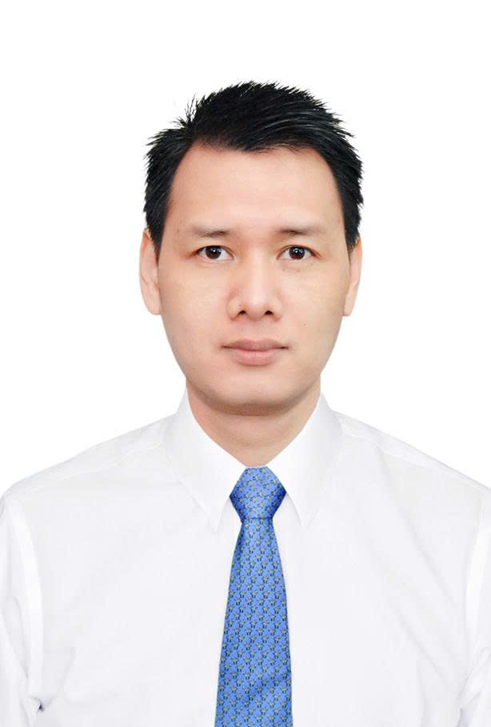
HOW HPIE SUPPORTS FOREIGN OEMs
CAPABILITY STATEMENT 2026
FROM SITE READINESS TO LOCAL FOLLOW-UP
OPERATING MODEL
One local point of contact across the project lifecycle
BEFORE SHIPMENT
DURING INSTALLATION
AFTER COMMISSIONING
Site survey
Utilities / foundation / access
Unloading & lifting plan
Manpower & contractor planning
Unloading • rigging • positioning
Mechanical & MEP coordination
OEM engineer support
Progress tracking
Punch list & customer follow-up
Local inspection / troubleshooting
Spare parts & maintenance
coordination
Local point of contact
FOCUS INDUSTRIES & EQUIPMENT
Where HPIE can create practical value
PACKAGING & FOOD PROCESSING
INDUSTRIAL AUTOMATION
METALWORKING & PRODUCTION
Packaging machinery • food processing
• production lines • food-service
technology
Automation • assembly machines •
special-purpose machines • handling
systems
Metalworking • fabrication • production
machinery • auxiliary systems
SURFACE TREATMENT / COATING
COMMERCIAL & INDUSTRIAL
IMPORTED MACHINERY PROJECTS
Powder coating • spray equipment •
pretreatment • painting / finishing
systems
Commercial / industrial kitchen •
environmental • oil / waste management
Overseas manufacture → shipment →
installation → utilities → commissioning
→ handover
WHY HPIE
FOUNDER / KEY TECHNICAL CONTACT
Built for practical OEM support in Vietnam
ALEX PHUC
Local presence in Northern Vietnam
Founder / Technical Business Development
Mechanical + project engineering background
17+ YEARS
Founder-level professional experience
in engineering, equipment and project
execution.
English–Vietnamese technical coordination
Imported equipment project experience
Flexible project-based, non-exclusive support
Local contractor and technician coordination
LOOKING FOR A LOCAL TECHNICAL PARTNER IN VIETNAM?
HPIE VIET NAM | +84 968 313 362 | alex@hpievietnam.com
www.hpievietnam.com
GENERAL info@hpievietnam.com • SALES sales@hpievietnam.com • PARTNERS partners@hpievietnam.com • PROJECTS projects@hpievietnam.com
HPIE Viet Nam | Industrial Machinery • Engineering • Project Solutions
02

